Slide 1
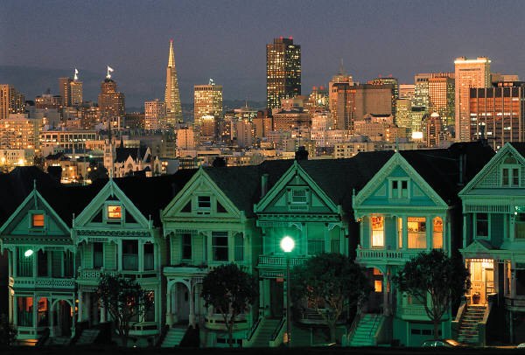
My Trip
Members:
JIAXIN LI
TANMAY GROVER

Slide 2
What is My Trip ?
It is a native iOS Application that allows us to build a diary of our trip. It will help us mark and record the places we went along with a small description and picture of the place we visited. There are other similar applications like Diary, Instagram & Facebook. However, My Trip is mainly based on one’s trip details, hence provides more richer and a compelling user experience.

Slide 3
Features
TRIP HISTORY
EVENTS
EVENT – ARTICLE, PICTURES
NEW EVENT
NEW TRIP
GPS

Slide 4
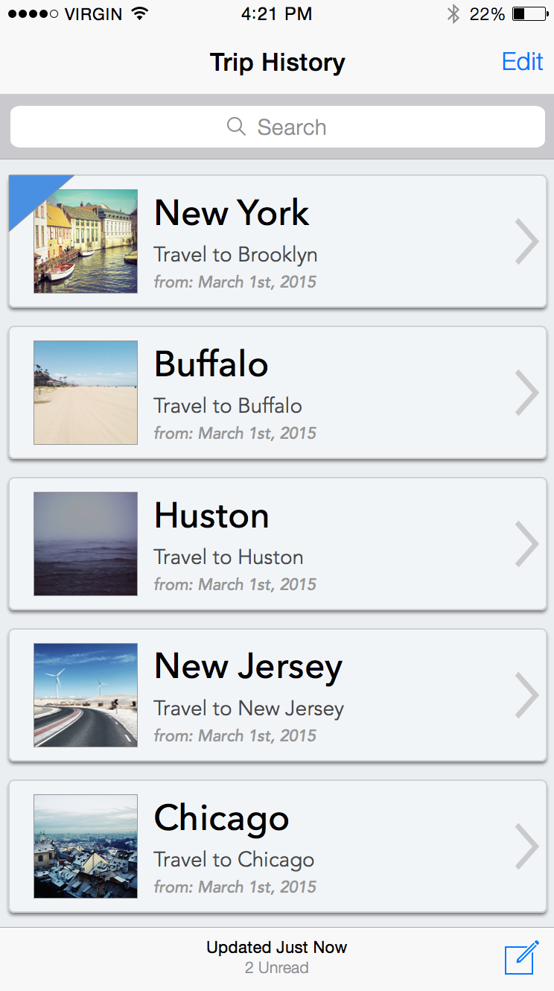
TRIP HISTORY
As soon as you login, a trip history will be displayed in a list view. Details of each trip would be included – place and date. This page also has identification and action elements :-
A blue Triangle is to identify the current trip.
A pencil at the bottom right creates a new Trip.

Slide 5
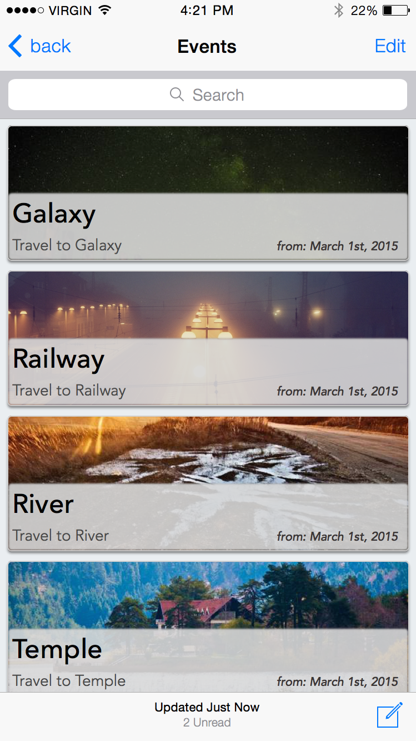
EVENTS
Events are places that you have covered in a trip. It may include all the details relevant to the place –picture, article etc. These lists of events can be created for each Trip.

Slide 6
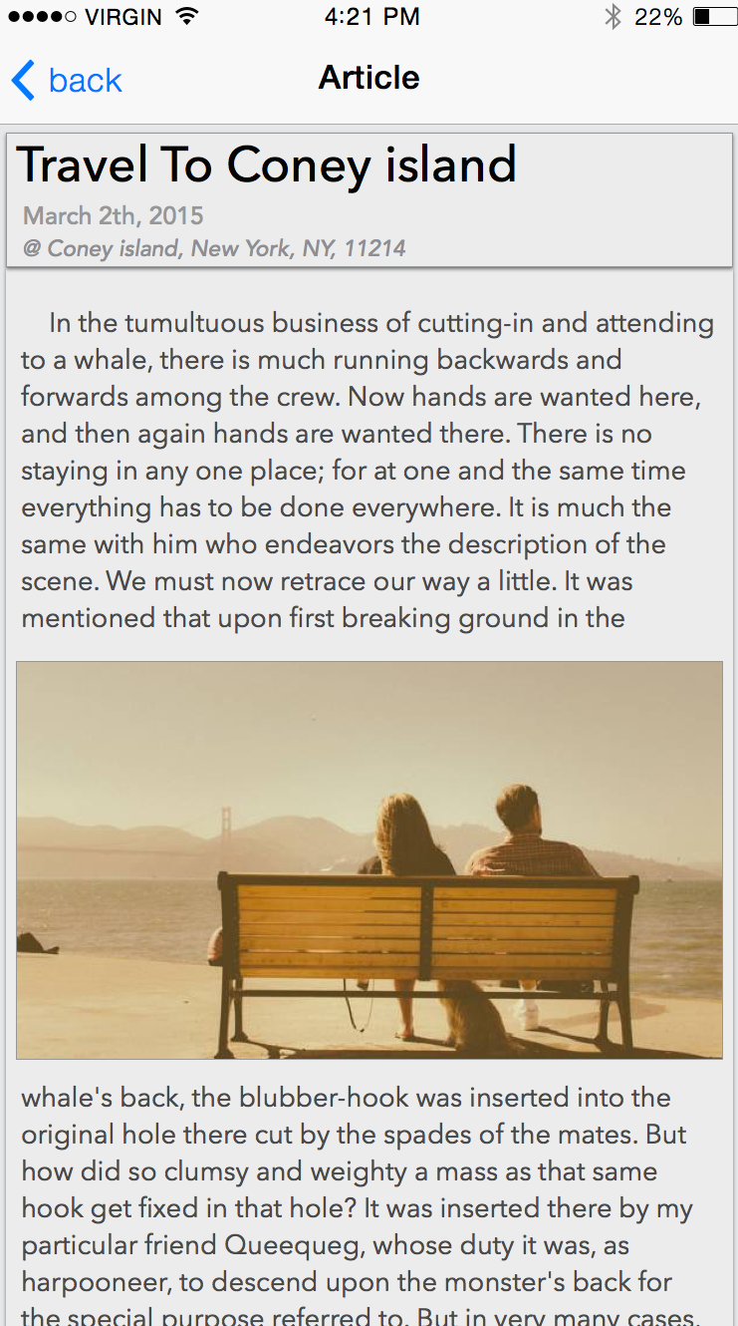
EVENT ARTICLE
An event article is a feature of the EVENT that enables you to write your thoughts instantly. For, instance you may write history about that place, short story,. personal moment or just your experience.

Slide 7
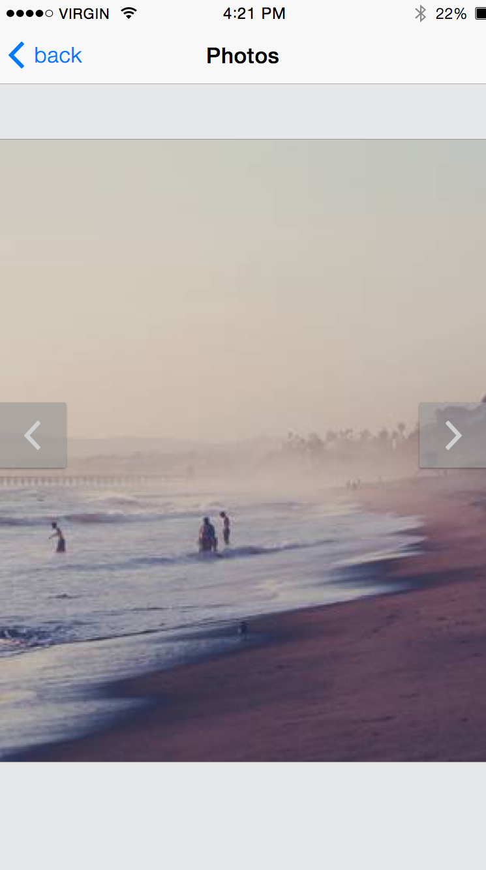
EVENT- PICTURE
You can store pictures that correspond to particular events. You can have many pictures for a single event. To see pictures you slide-away each picture and then view it.

Slide 8
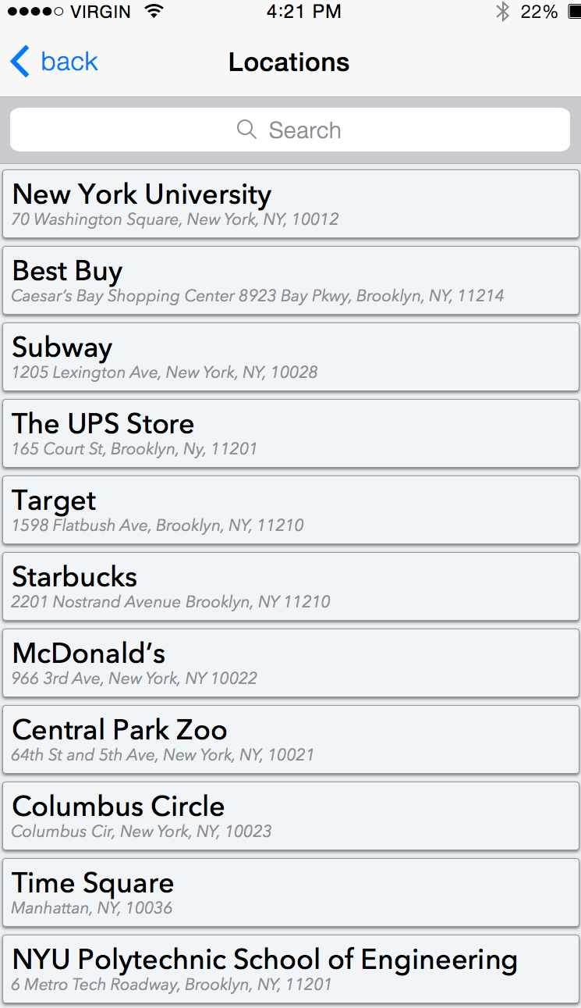
GPS
You can find and tag the event by including locations as well. Locations are are searched by using GPS.

Slide 9
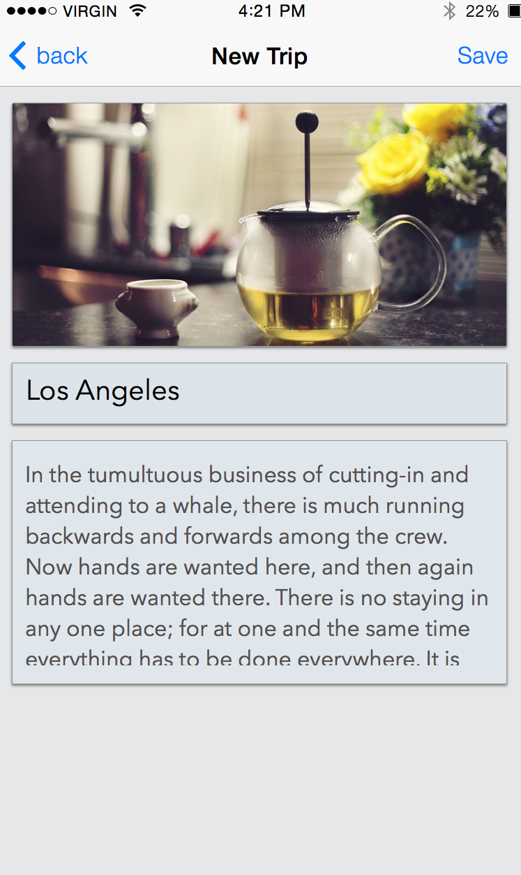
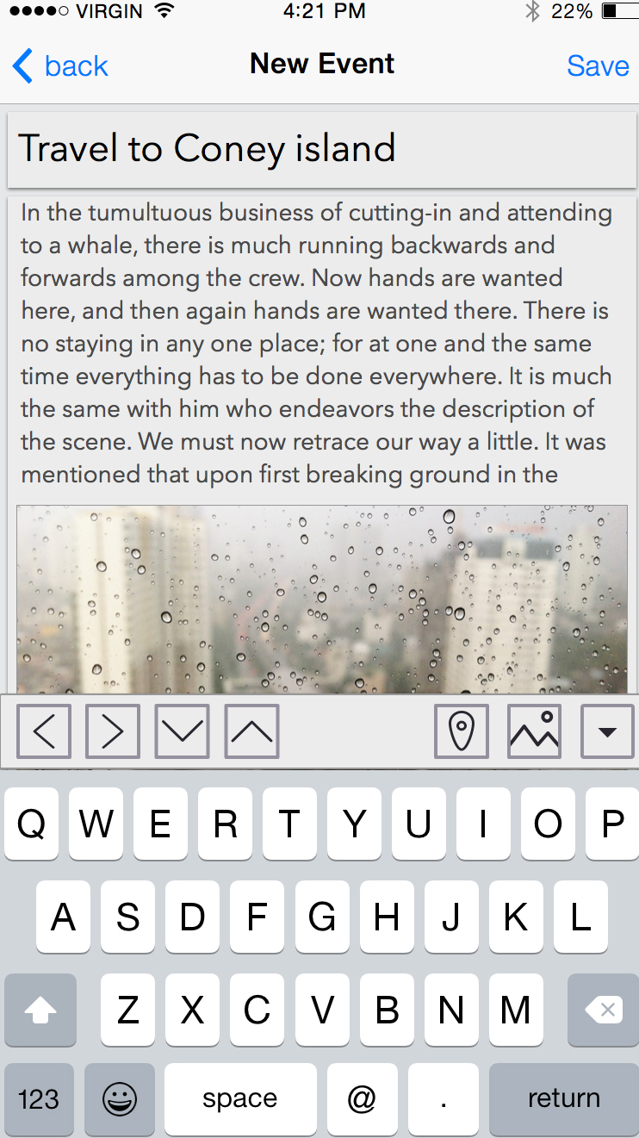
New TRIP & EVENT
New Trips and New Events can be added.

Slide 10
References
Technology we are using : Simple iOS Swift GUI Application, SKETCH for designing.
1) http://www.invisionapp.com/tour/iphone-ipad-prototyping
2) https://www.youtube.com/watch?v=FYElY4ewq_o
3) https://developer.apple.com/swift/blog/?id=16
Also, if we could think of a new feature that adds value to our project then we would include it as we proceed to next milestone.

Slide 11
Thank you !

